Slide 1
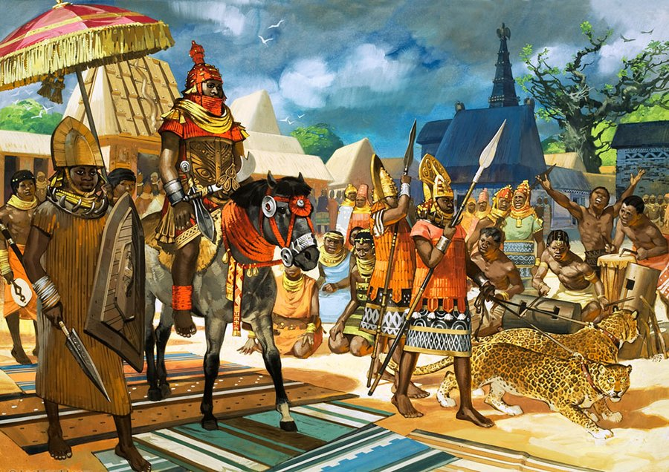
African Vocabulary

Slide 2
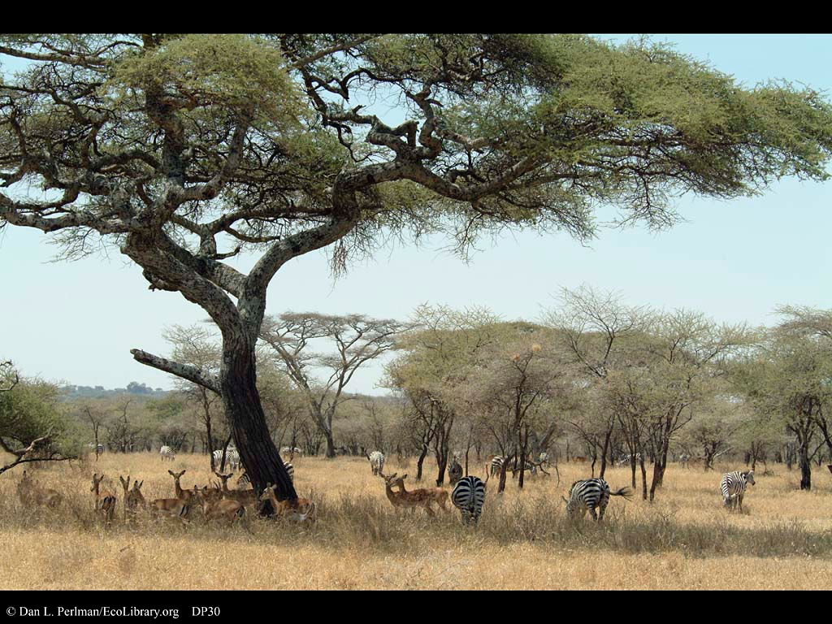
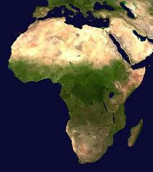
Savanna
A short grassy plain
A fertile area of land just south of the Sahara Desert.

Slide 3
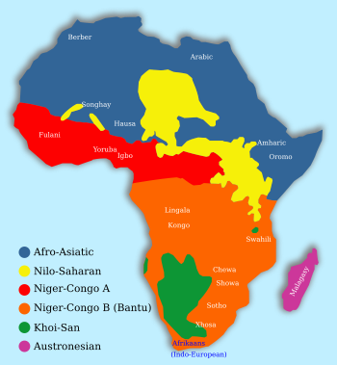
Bantu
Any of a number of languages with word similarities in Africa.
Different types African languages that a similar to one and another.

Slide 4
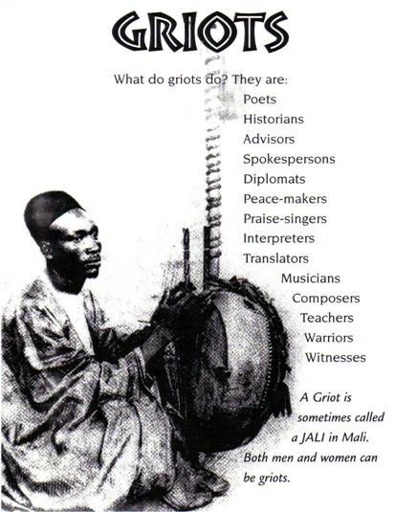
Griot
A professional storyteller in Africa
A person who passes down African history through stories

Slide 5
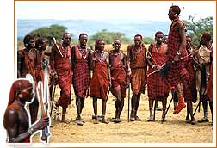
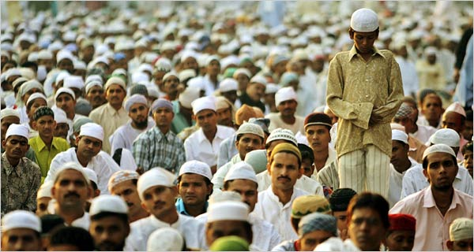
Swahili
A culture and language that combines African and Arabic cultures and languages.
+
A combination of both African and Arabic cultures and languages

Slide 6
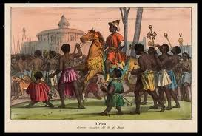
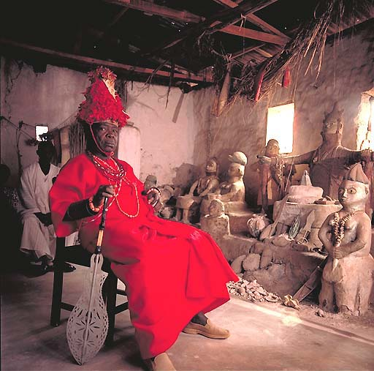
Oba
A king of Benin
A ruler of Benin

