Slide 1
Religion Vocabulary

Slide 2
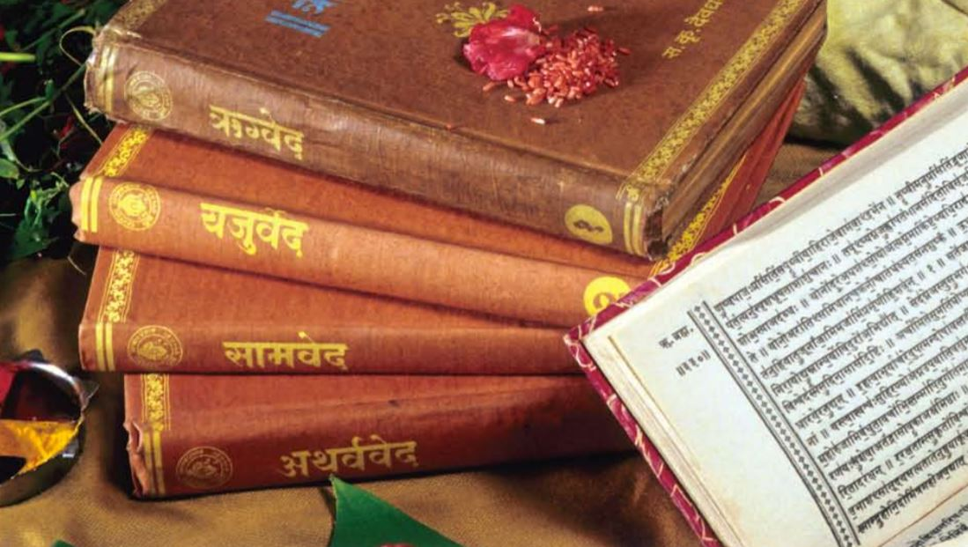
Vedas
Definition: The ancient sacred texts of Hinduism.
In my own words:
Holy Book of Hinduism

Slide 3
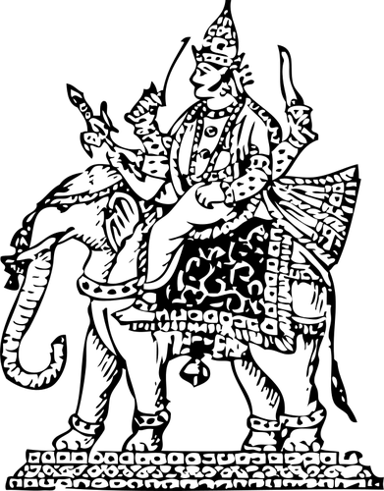
Reincarnation
Definition: Rebirth of the soul in a new body after death.
In my own words:
The belief a person lives many lives and are
Reborn into a new life.

Slide 4
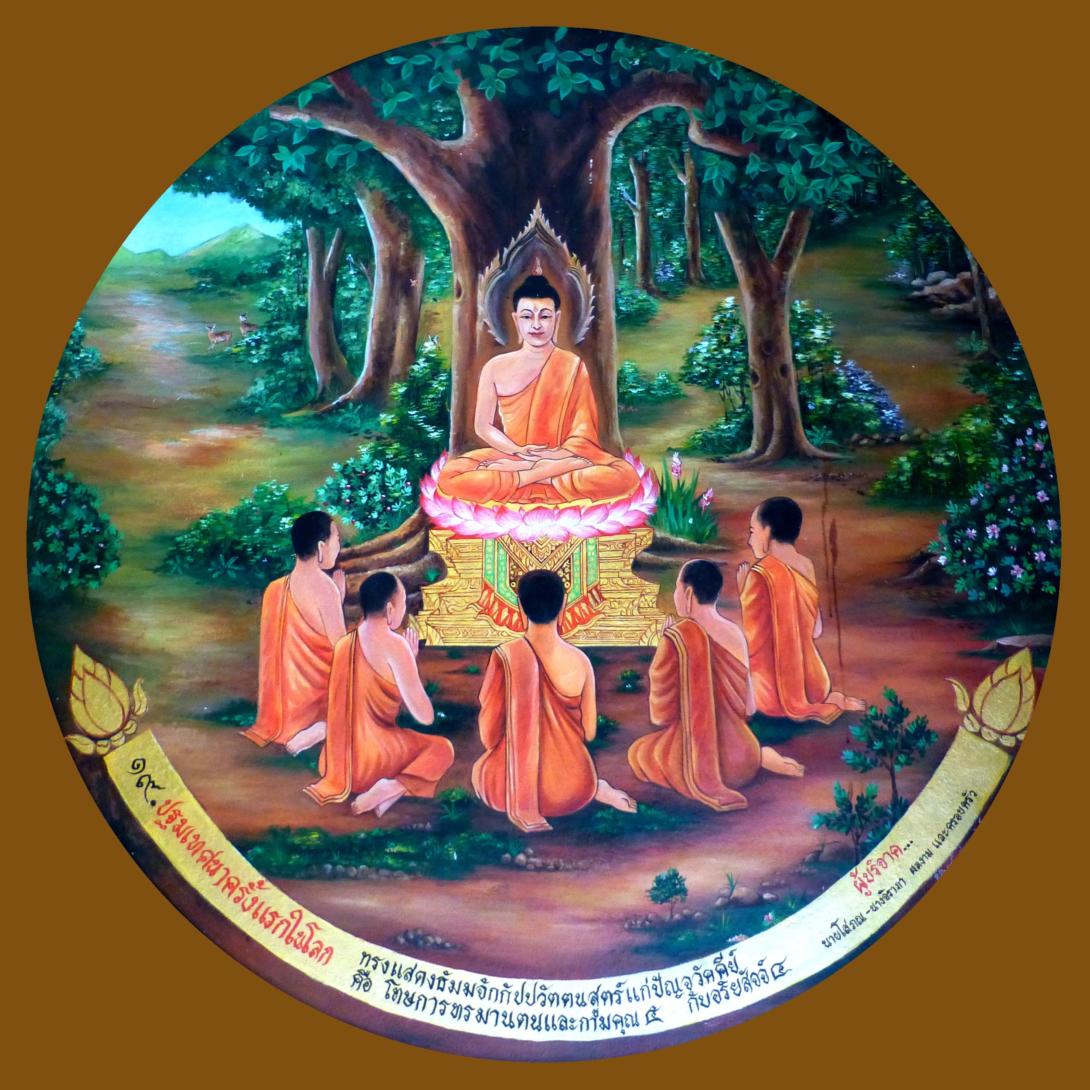
Four Noble Truths
Definition: The four central beliefs containing the essence of Buddhist teaching.
In my own words:
4 Truths of life

Slide 5
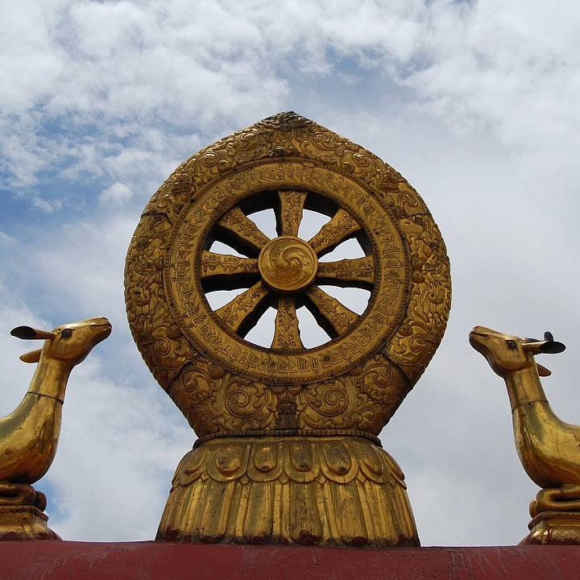
Eightfold Path
Definition: The Path to the end of suffering.
In my own words:
8 Rules Buddhists must follow

Slide 6
Covenant
Definition: A formal alliance or agreement made by God with a religious community or with humanity in general.
In my own words:
An agreement made with God

Slide 7
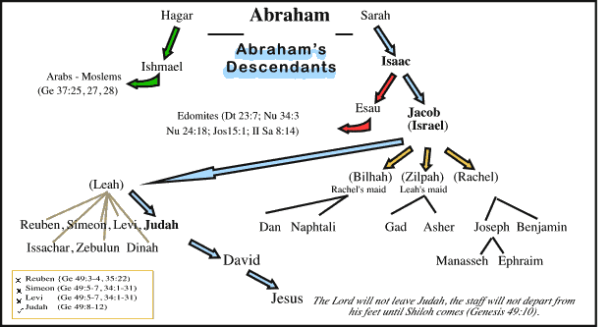
Descendants
A person born later into the same family
In my own words:
Family

Slide 8
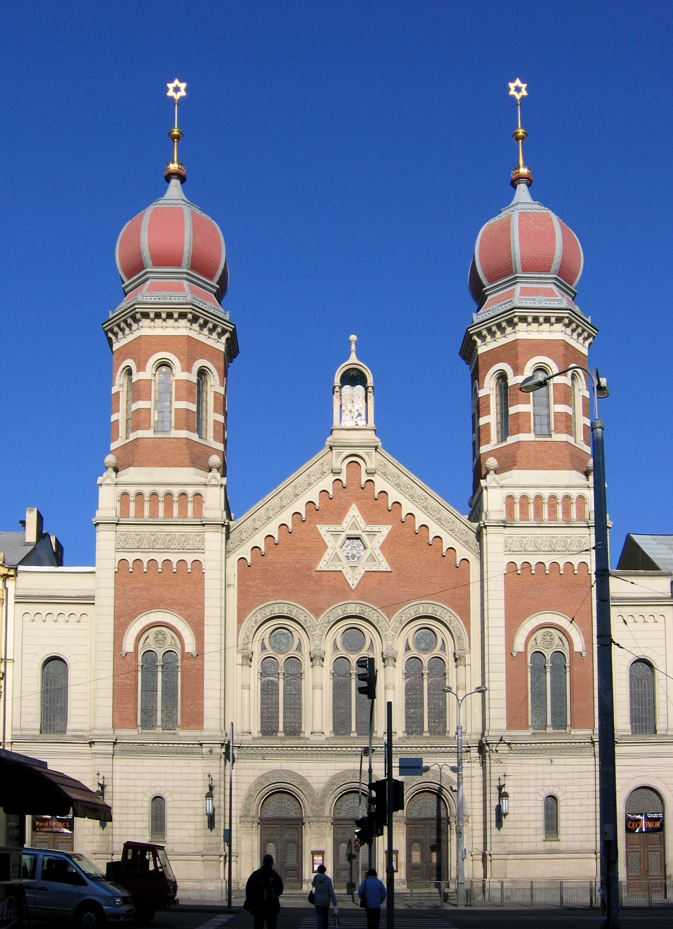
Synagogue
Definition: A Jewish house of worship.
In my own words:
Holy Place for Jews, like a church

Slide 9
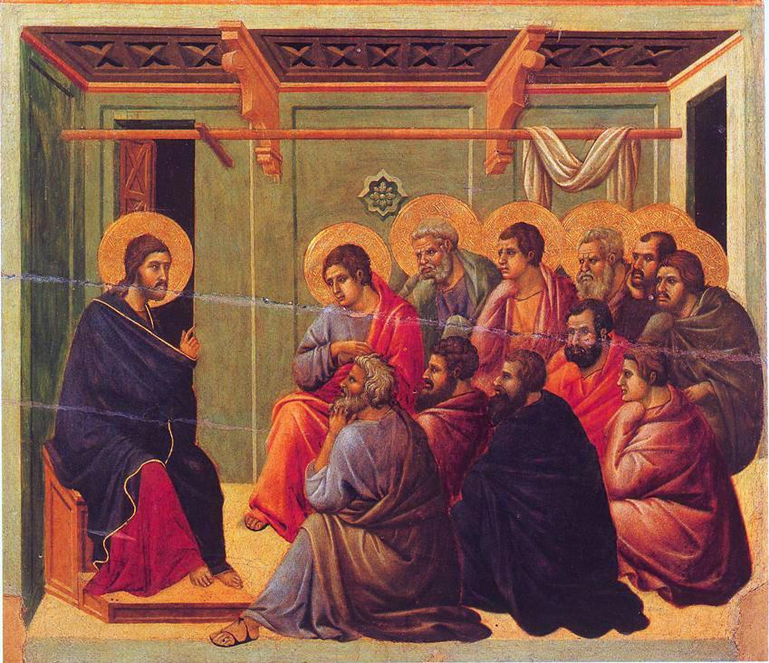
Disciple
Definition: One who follows a leader or teacher.
In my own words:
Closest followers of Jesus

Slide 10
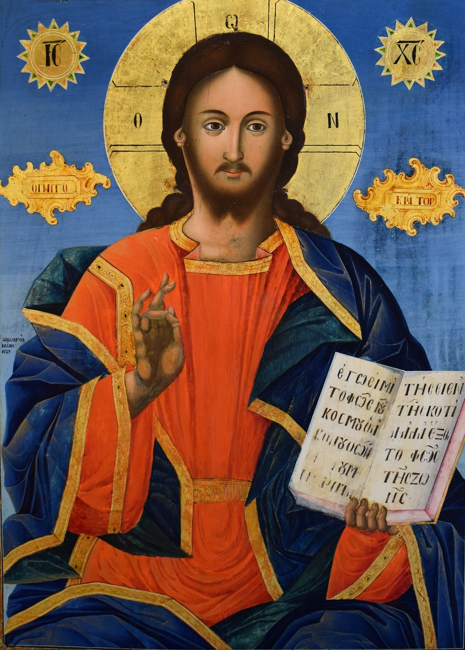
Messiah
Definition: The figure promised by God to the Jews for the salvation of the world.
In my own words:
The savior. Believed to be
Jesus Christ

Slide 11
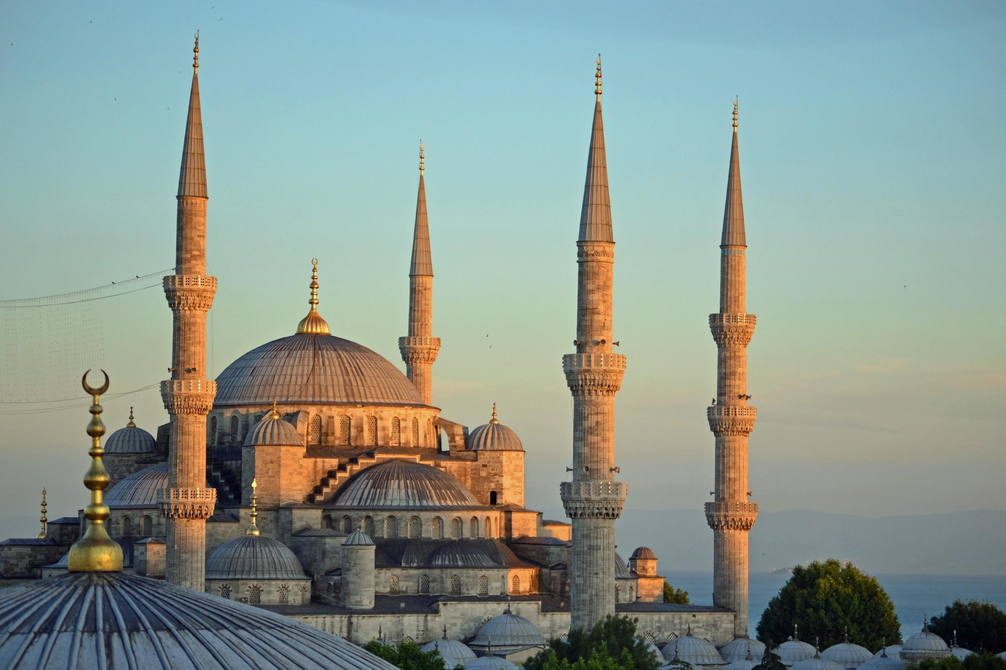
Mosque
Definition: A mosque is a place of prayer for Muslims, or followers of the religion of Islam.
In my own words:
Muslim holy place, like a church

Slide 12
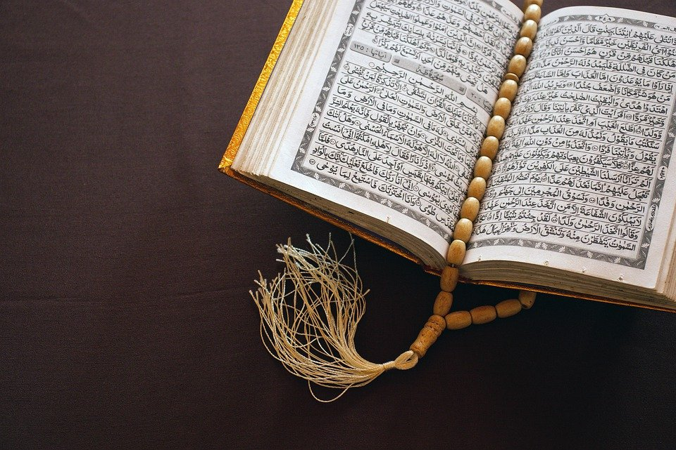
Quran
Definition: The holy book of Islam.
In my own words:
Muslims holy text

Slide 13
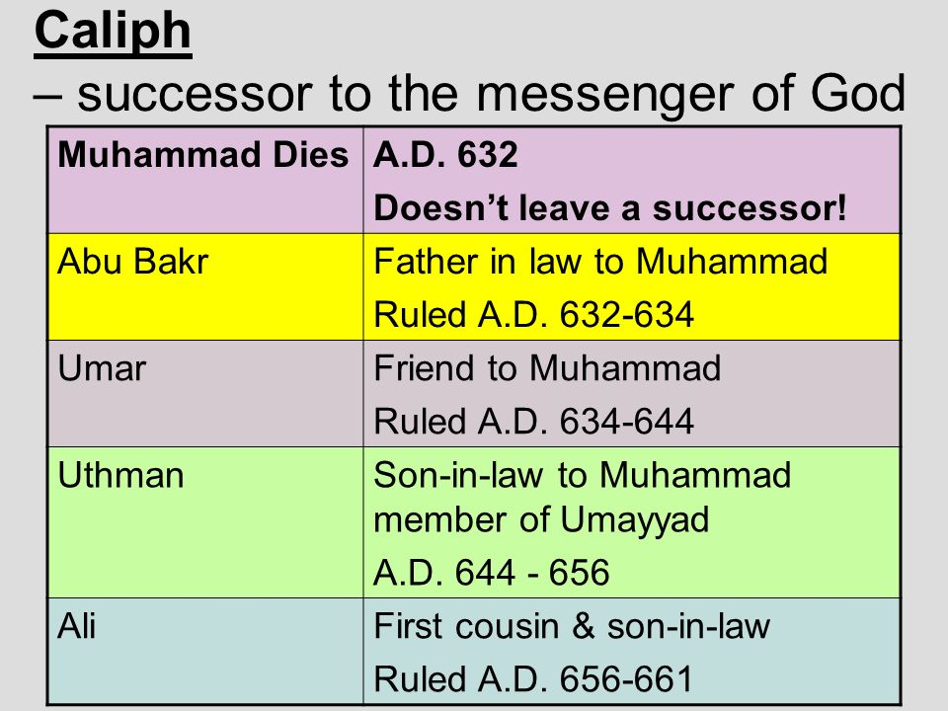
Caliph
A successor to Muhammad
In my own words:
Religious leaders after the prophet Muhammad

