Slide 1
82 Spring Break 3/31
What did you do over spring break?
CANT SAY NOTHING!!!!
When you finish update your notebook while I pass back projects and papers

Slide 2
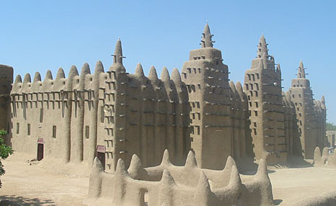
West African Kingdoms

Slide 3
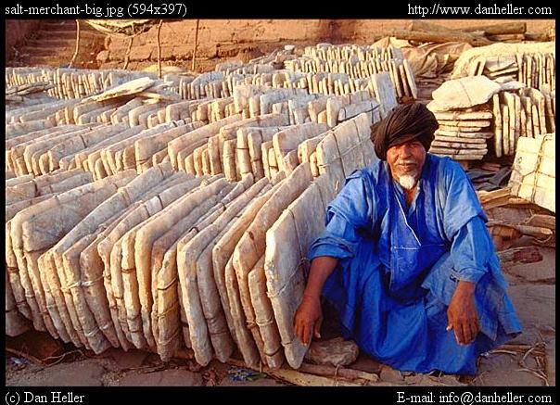
Building Background
Different regions in Africa have different resources.
Some places in West Africa have gold, whereas others have salt.
At times, salt was so valuable in Africa that people traded gold for salt evenly.
The salt and gold trade lead to the 1st empire in West Africa.

Slide 4
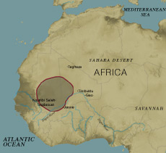
The Beginning of Ghana
The earliest group to settle in W. Africa was the Soninke (suhn IHN kay)
They settled on the Niger River in 300 A.D. as a way to protect against enemies.
This is the beginning of Ghana empire
Grew in strength because of iron and an increase in food production = larger population

Slide 5
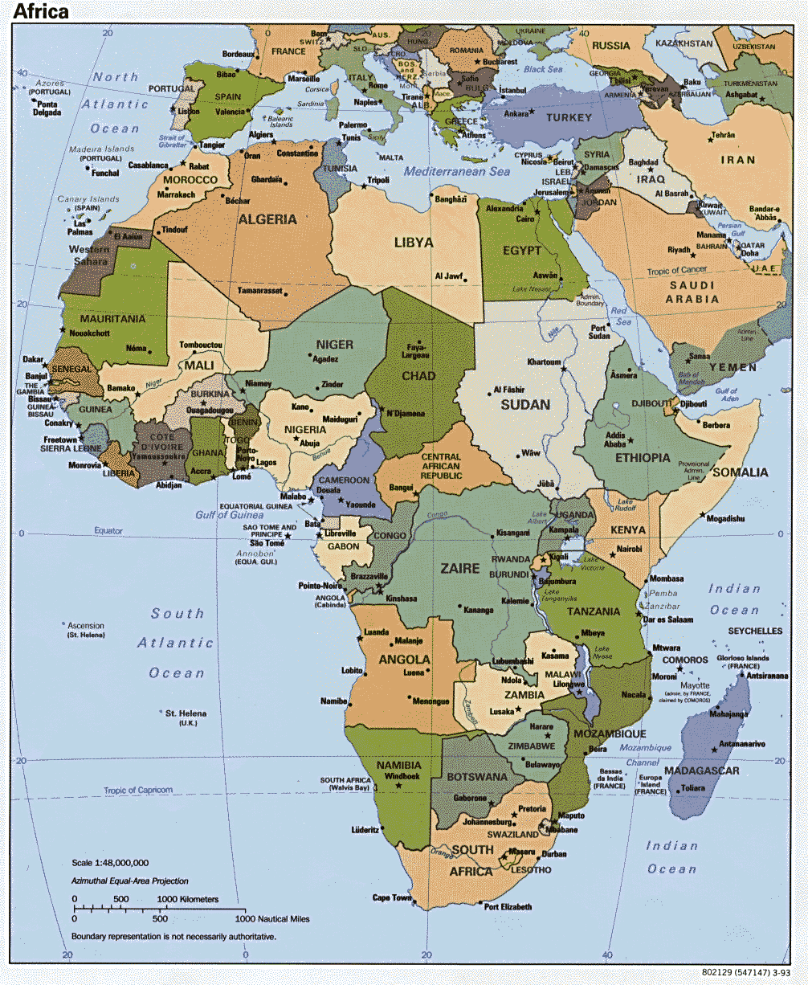
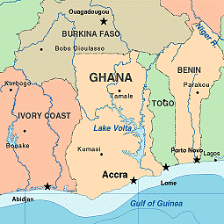

Slide 6
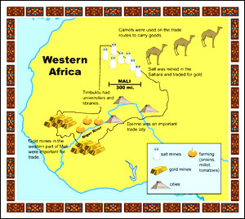

Slide 7
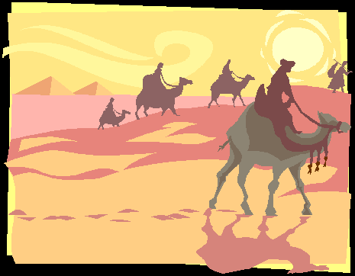
Ghana’s Location
Ghana lays between the Sahara Desert to the North and vast forest to the South
Because of the location this was a great place for trading the 2 most important resources.
Gold
Salt

Slide 8
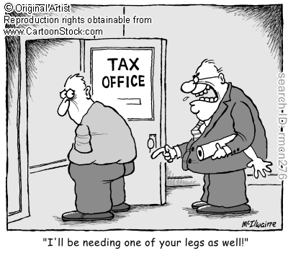
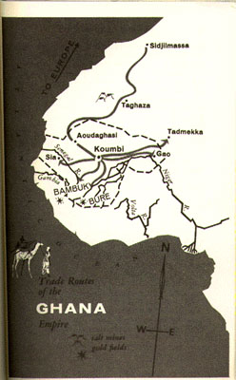
Ghana Builds an Empire
As trade in Ghana increased so did its power.
By 800 A.D. they controlled most of the trade routes and became very wealthy
Ghana’s rulers looked for even more ways to make money. They began to tax merchants for using their trade routes (x2).

Slide 9
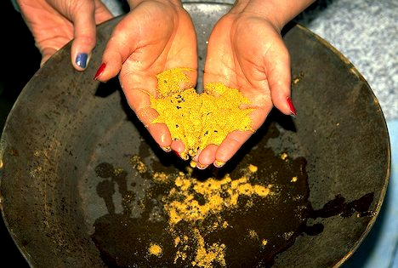
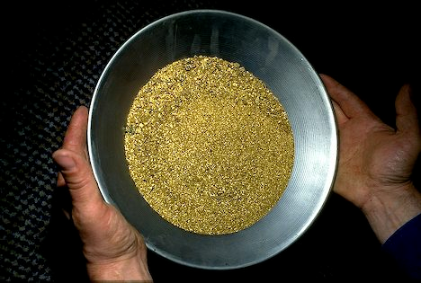
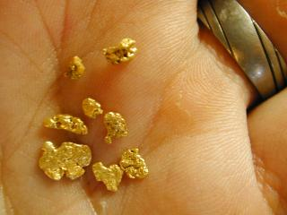
Expansion of Ghana
Gold mines brought in even more money.
Laws were past so that commoners couldn’t own gold nuggets. This was to insure the king was richer than the people.

Slide 10
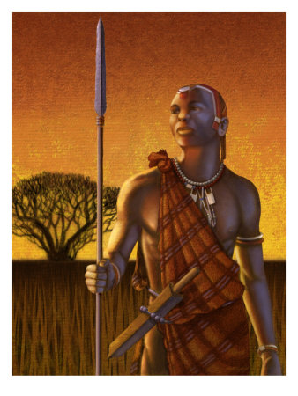
Expansion of Ghana
The wealth of Ghana was also used for its powerful army.
The use of Iron also allowed its army to conquer its neighbors easily.
(Story of Iron in Africa)
By 1068 Ghana was at its most powerful

Slide 11
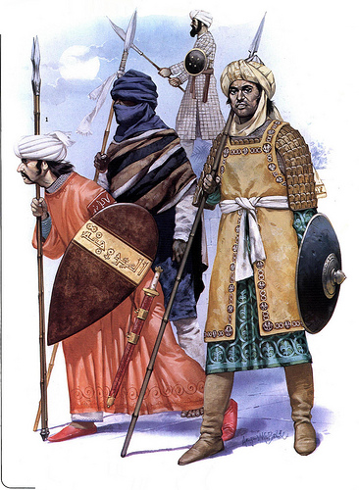
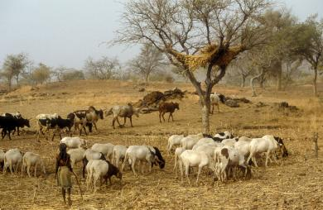
Ghana Declines
By the early 1200s the empire begins to collapse
1. Invasion = N. African Muslims attack for 14 yrs. Cutting off trade routes and weakening the empire.
2. Overgrazing = Animals eat all the grass, which makes farmers leave to find better soil
3. Internal Rebellion = Conquered people rise up and rebel.

Slide 12
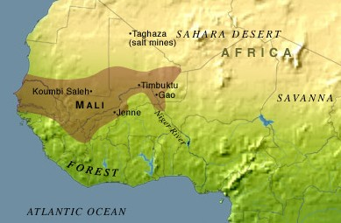
Rising from the Ashes
Rising from the ruins of Ghana, Mali took over the trade routes of W. Africa
Like Ghana, Mali lay on the upper Niger river and controlled important trade routes.
Fertile soil help the empire grow.

Slide 13
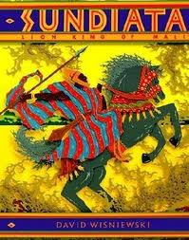
Sundiata “Lion Prince” Makes Malian Empire
Mali’s rise to power began under a ruler named Sundiata.
Sundiata built a large army in order to win Mali’s independence from a harsh ruler.
He then took over the gold & salt trade.

Slide 14
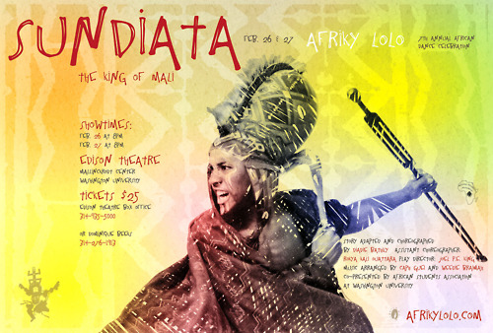
Sundiata’s Rule
Improved agriculture in Mali
New farmland cleared (beans, onions, & rice)
Introduced cotton (for trade and clothes)
Named himself Mansa
Previously Mansas had political and religious role in society. This gave him even more power.
During his rule he converts to Islam.
Dies in 1255 (unknown)
Later rulers took on the title on Mansa and the majority of them were Muslims.

Slide 15
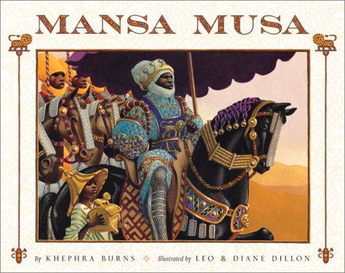
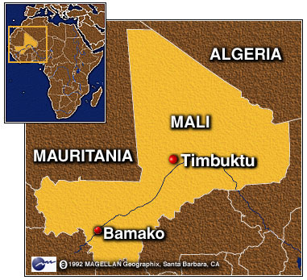
Mansa Musa Rule
Mansa Musa lead Mali to its height in wealth, power, & fame in 1300.
His influence causes Islam to spread W. Africa.
Ruled for 25 yrs.
(1312-1337)
Ruled 40-50 million people
Added many important trade routes, including Timbuktu.
He also supported Education.
Set up schools
Had Islamic educators come to Mali to teach Arabic in order to read the Quran

Slide 16
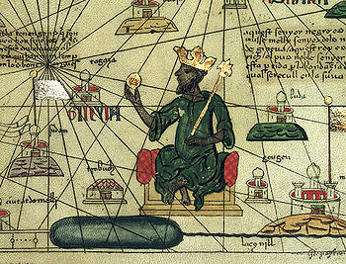
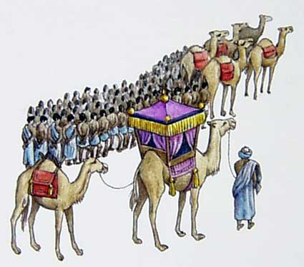
Mansa Musa makes his Pilgrimage to Mecca
The Islamic faith was very important to Mansa Musa.
He left for Mecca in 1324
Because of his pilgrimage Mali was noticed by the rest of the world. In his travels he brought
Tons of Gold
1000’s of people
Camels

Slide 17
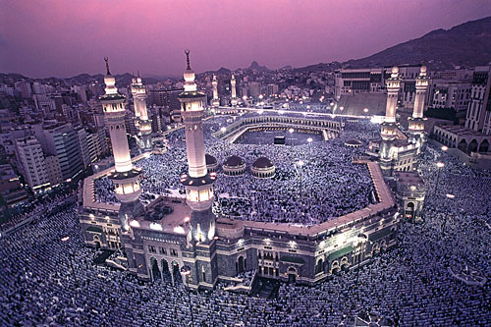

Slide 18
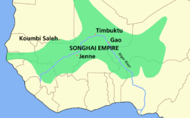
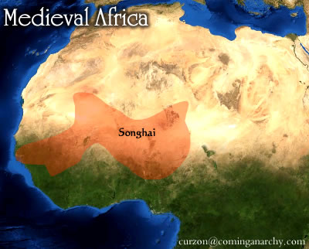
The Fall of Mali
After Mansa Musa died his son took over.
His son was a weak ruler.
As Mali was reaching its height, a rival power was growing; the Songhai
Raiders from Southeast Africa invaded & destroyed much of the land.
By the 1500’s most of the land was lost

Slide 19
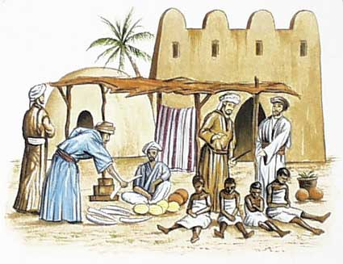
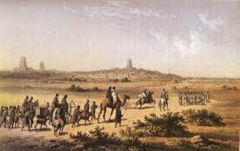
Building of an Empire
The Songhai rebelled in the 1400’s from the weakening Mali Empire.
Didn’t want to pay taxes
The Songhai leaders were Muslims.
Because of this religious connection people were willing to trade.

Slide 20
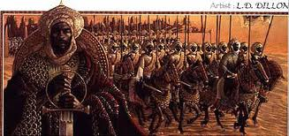
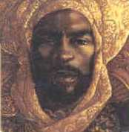
Sonni Ali
Sonni Ali became ruler in 1464
He unified and strengthened the empire.
Professional army & navy
Much of the land that once belonged to Mali was now controlled by the Songhai Empire.
The Songhai empire was larger than either Ghana and Mali

Slide 21
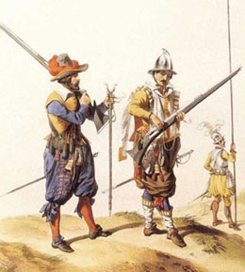
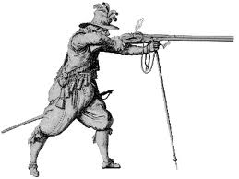
Songhai Falls to Morocco
The North African rival, Morocco, wanted to gain control of the salt mines.
They set out to city Gao in 1591
The soldiers had advanced weapons including the arquebus.
Arquebus = early form of gun.
Swords, spears, and bows were no match for the guns & cannons.
The change of trade patterns completed the fall.
Slowly, the period of great West Africa Empires came to an end.

